Slide 1
Batfish: Make BGP route-leaks history
February 2020
Samir Parikh
samir@intentionet.com

Slide 2


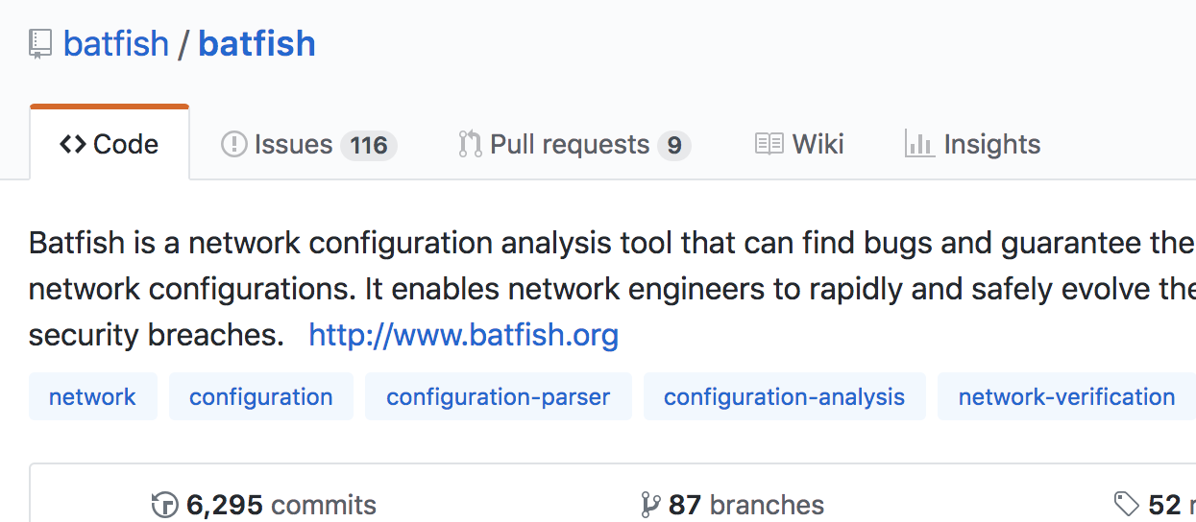
What is Batfish?
Pre-deployment network validation solution
Started as a Microsoft Research project in 2012
Open sourced in 2014 (Apache 2.0)
Contributors from Intentionet, BBN, Colgate University, Microsoft, Princeton, UCLA, USC, …
Used by many Fortune 500 companies

Slide 3


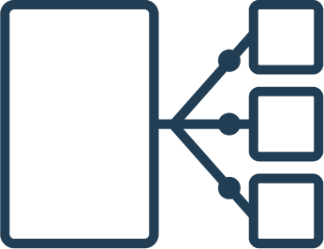




How It Works
Notes:
Dynamic state is NOT required for pre-deployment validation.

Slide 4







How It Works
And many
more…
Notes:
Dynamic state is NOT required for pre-deployment validation.

Slide 5
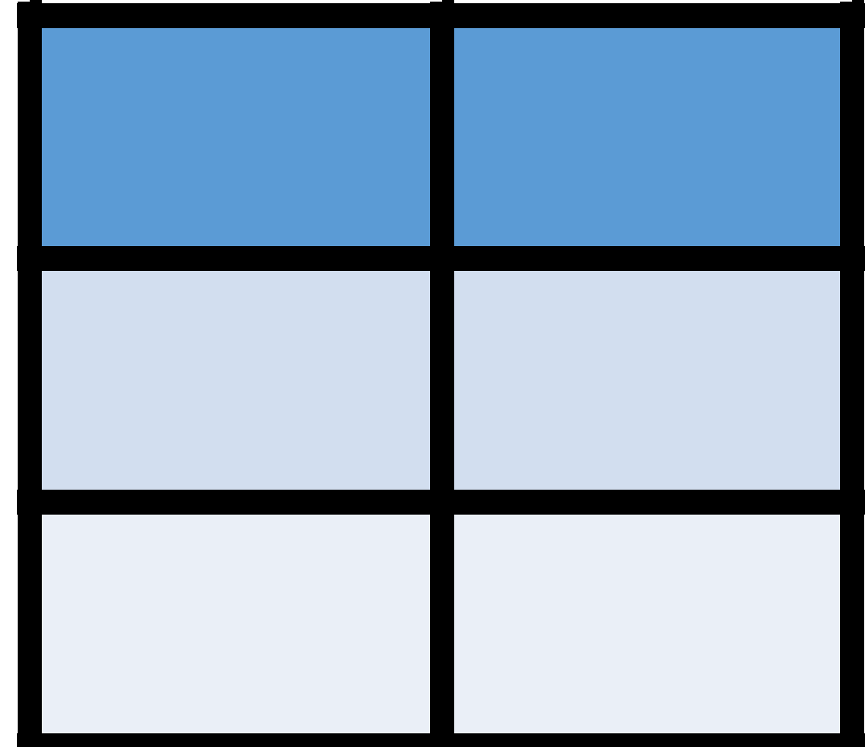
How It Works
Vendor Neutral
Configuration Model
Routing
Model
Mathematical Model of Network Behavior
Interfaces:
Ethernet0/0:
InterfaceBW: 10e6,
InputFilter: filter_in
……….
192.0.0.0 ≤ out.prefix
out.prefix ≤ 192.1.0.0
best.valid ⇒ out.lp = 120
best.valid ⇒ out.ad = 20
………
Queries
Network models
Analysis engine
Policies
Notes:
Dynamic state is NOT required for pre-deployment validation.

Slide 6



Batfish Policies and Queries
Configuration Audit
Comprehensive Firewall/ACL Analysis
Are all devices compliant with site standards?
Are all protocol sessions (BGP, IPsec, MLAG, …) compatible?
Is my firewall protecting sensitive services?
What is the impact of this ACL change?
Route and Forwarding Analysis
Comprehensive Reachability Analysis
Is my network redundant?
What happens if I change this route policy?
Can any flow violate cross-site isolation?
Is the DNS server accessible from anywhere?
Notes:
Remember, Batfish can do all of this just based on configurations and all of this can be done before you deploy the config

Slide 7
Live Demonstrations
Leverage Batfish for continuous configuration validation
Analyze a change to a routing policy
Identify and prevent potential route-leak

Slide 8
DEMO #1 – Continuous configuration validation
cust01
cust02
pe1
pe2

Slide 9

DEMO #1 – Continuous configuration validation
This demo uses Batfish to build an test suite for multi-vendor configuration validation
Tests inspired by MANRS guidelines
https://github.com/manrs-tools/MANRS-validator

Slide 10
DEMO #1 – Continuous configuration validation
def test_customer_bgp_session_input_policy(bf, customer_list): """Ensure all customer BGP peering sessions have INPUT policy configured""" bf.asserts.current_assertion = 'Assert all customer BGP sessions have input route policy' nodes = [] # determine the list of peering nodes which need to be evaluated for customer in customer_list: nodes.append(customer['Node']) nodespec = ','.join(nodes) # retrieve the BGP session configuration for all peers on the peering nodes df = bf.q.bgpPeerConfiguration(nodes=nodespec).answer().frame() bad_peers_in = [] for customer in customer_list: # check the BGP session configuration for specific peers and # extract input routing policy iPol = df[(df['Node'] == customer['Node']) & \ (df['Remote_IP'] == customer['Remote_IP'])]['Import_Policy'] if len(iPol.iloc[0]) == 0: bad_peers_in.append(f"{customer['Node']}:{customer['Remote_IP']}") test = (len(bad_peers_in) == 0)
Vendor agnostic policies
Example
Ensure all customer BGP sessions have an input policy

Slide 11
DEMO #2 – Test a routing policy change
cust01
cust02
pe1
pe2

Slide 12
DEMO #2 – Test a routing policy change
PE Input policy for cust01
ip as-path access-list customer1 permit ^609 ! ip prefix-list customer1 deny 10.0.0.0/8 le 32 ip prefix-list customer1 deny 0.0.0.0/0 ip prefix-list customer1 deny 127.0.0.0/8 le 32 ip prefix-list customer1 deny 0.0.0.0/8 le 32 ip prefix-list customer1 permit 0.0.0.0/0 le 32 ! ip community-list expanded customer1 permit _609:.*_ ! route-map customer1-in permit 10 match as-path customer1 match ip address prefix-list customer1 match community customer1 set community 609:1 ! route-map customer1-in deny 20
cust01
cust02
pe1
pe2

Slide 13
DEMO #2 – Test a routing policy change
Update policy to block /24 prefixes
ip as-path access-list customer1 permit ^609 ! ip prefix-list customer1 deny 10.0.0.0/8 le 32 ip prefix-list customer1 deny 0.0.0.0/0 ip prefix-list customer1 deny 127.0.0.0/8 le 32 ip prefix-list customer1 deny 0.0.0.0/8 le 32 ip prefix-list customer1 permit 0.0.0.0/0 le 32 ! ip prefix-list BLOCK24 permit 0.0.0.0/0 ge 24 ! ip community-list expanded customer1 permit _609:.*_ ! route-map customer1-in deny 10 match ip address prefix-list BLOCK24 ! route-map customer1-in permit 20 match as-path customer1 match ip address prefix-list customer1 match community customer1 set community 609:1 additive
!
route-map customer1-in deny 30
cust01
cust02
pe1
pe2

Slide 14
DEMO #2 – Test a routing policy change
Process to analyze routing policy change
Collect BGP-Adj-RIB-In for peer in question
Upload snapshot with current and proposed policy to Batfish
Compare Batfish routing policy evaluation between current and proposed policy

Slide 15
DEMO #3 – Prevent a route-leak
cust01
cust02
isp01-nyc
pe1
pe2
isp02-chi
isp01-den
pe3

Slide 16
DEMO #3 – Prevent a route-leak
Scenario
Peer AS isp01 wants to send prefixes of length >/24 to load-balance traffic across peering links
Validation Steps
Collect BGP-Adj-RIB-In and verify that existing policy blocks >/24 prefixes
Update policy and test to verify that policy accepts prefixes
Validate that prefixes are not exported out of your AS
Repeat 3 & 4 until policy is correct

Slide 17
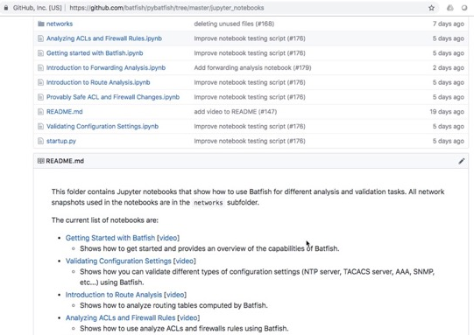
Getting Started with Batfish is easy!
One line with Docker https://batfish.readthedocs.io/en/latest/getting_started.html#installing-batfish
Advanced tutorials & videos
https://www.github.com/batfish/pybatfish/ tree/master/jupyter_notebooks
https://www.youtube.com/channel/ UCA-OUW_3IOt9U_s60KvmJYA

Slide 18
Download the presentation and demo
https://github.com/saparikh/nanog78-demo

Slide 19

Validate your BGP policies with Batfish!
batfish-org
@batfish
batfish.org

Slide 20
Thank You

